Slide 1
Introduction to large-scale organisations
Characteristics

Slide 2
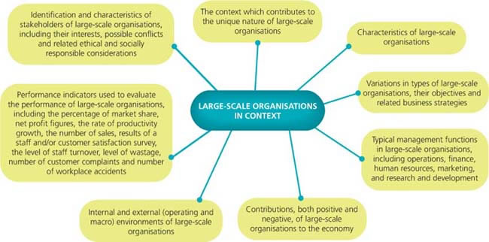
KEY KNOWLEDGE Use each of the points below from the Business Management study design as a heading in your summary notes.

Slide 3
Key concepts
An organisation is created when two or more people work together to achieve their common objectives.
Large-scale organisations are characterised by a large number of employees, a large amount of assets and large revenue.
Large-scale organisations typically have management functions called operations, finance, human resources, marketing and research and development.

Slide 4
Characteristics
The Australian Bureau of Statistics defines a large-scale organisation (LSO) as –
employs 200 or more people
has assets (what the organisation owns) worth more than $200 million
may earn revenue in the millions
may be multinational
has a large market share

Slide 5
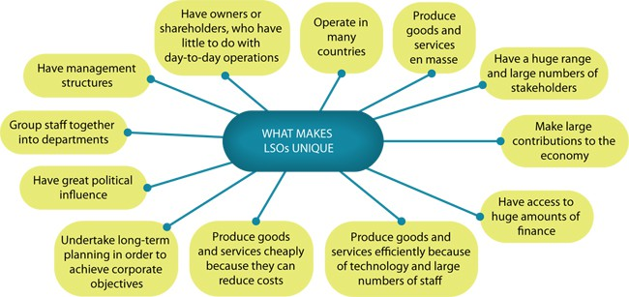

Slide 6
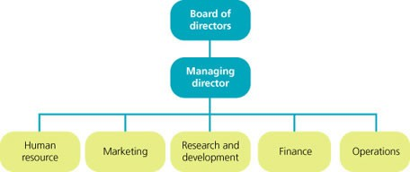
Typical management functions in an organisational structure

Slide 7
1.2 Variations in types of large-scale organisations
Key concept
The main types of large-scale organisations in Australia include
corporations
government departments
not-for-profit organisations.
They vary in terms of their ownership and their purpose.

Slide 8
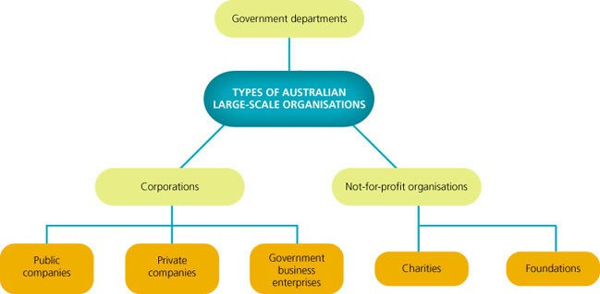
Types of Australian large-scale organisations

Slide 9
Corporations
A corporation, or company, is owned by shareholders and managed by directors. (A shareholder is any person who owns one or more shares in a company).
The main purpose of a corporation is to make a profit.
Shares in public companies are usually traded on the Australian Securities Exchange (ASX) egs BHP Billiton, Telstra and Virgin Blue
Private corporations are not listed on the ASX and have restrictions on who can buy shares. (1 – 50 shareholders) egs Rip Curl, 7 Eleven and Retravision

Slide 10
Government Business Enterprise (GBE)
owned and operated by the government.
carry out government policies while they deliver community services
usually with a board of directors that is accountable to the government for the GBE's performance.
GBEs are typically large, and include some of the largest employers of people in Australia. Australia Post, Medibank Private

Slide 11
Government departments
Government departments exist at all three levels of government (federal, state and local).
provide essential community services such as health, education and welfare examples Department of Education, Employment and Workplace Relations and the Department of Families, Housing, Community Services and Indigenous Affairs.

Slide 12
Not-for-profit organisations
include charities and foundations.
Their main purpose is to provide goods, services or funds to prevent particular social problems or to continue their work for the benefit of the community. Examples include the Salvation Army, World Vision, Anglicare, the Australian Conservation Foundation and The Smith Family.
do not generate business by selling products or services with the specific purpose of making a profit. Rather, they carry out their work freely or at a subsidised rate, and rely on volunteers, membership subscriptions and donations to continue operating.
The term ‘not-for-profit’ can actually be a little misleading, because many charities and foundations do make a ‘profit’. Any surplus made, however, is used to expand the organisation and to continue the work of preventing problems or helping those in need.

